Slide 1


Panuwat Tanapornchinpong
28/7/2022

Slide 2

Outline
Executive Summary
Introduction
Methodology
Results
Conclusion
Appendix

Slide 3
Executive Summary
Summary of methodologies
Data collection through SpaceX API
Data collection with Web Scraping
Data Wrangling
EDA with Data Visualization
EDA with SQL
Interactive Map with Folium and Plotly Dash
ML Prediction
Summary of all results
Exploratory data analysis results
Interactive analytics demo in screenshots
Predictive analysis results

Slide 4
Introduction
Project background and context
SpaceX advertises Falcon 9 rocket launches on its website with a cost of 62 million dollars; other providers cost upward of 165 million dollars each, much of the savings is because SpaceX can reuse the first stage. Therefore if we can determine if the first stage will land, we can determine the cost of a launch. This information can be used if an alternate company wants to bid against SpaceX for a rocket launch.
Problems you want to find answers
What factors do tell that the rocket will land success?
The interaction among features that determine success rate of landing
What operating conditions needs to ensure successful landing.

Slide 5

Section 1

Slide 6
Methodology
Executive Summary
Data collection methodology:
Using SpaceX API and web scraping from Wikipedia website.
Perform data wrangling
One-hot encoding was used to categorize features
Perform exploratory data analysis (EDA) using visualization and SQL
Perform interactive visual analytics using Folium and Plotly Dash
Perform predictive analysis using classification models
Using grid search and use many ML method such as LR, SVM.

Slide 7
Data Collection
Data was collected with various methods
Request data from SpaceX API
Decode the response content using .json function and turn to pandas dataframe
Check missing values . Then, clean the data if necessary
Also, do some web scraping from Wikipedia to get Falcon 9 launch records using BeautifulSoup.
The data from Wikipedia was recorded as HTML ,so it converted to pandas dataframe from easier analysis

Slide 8
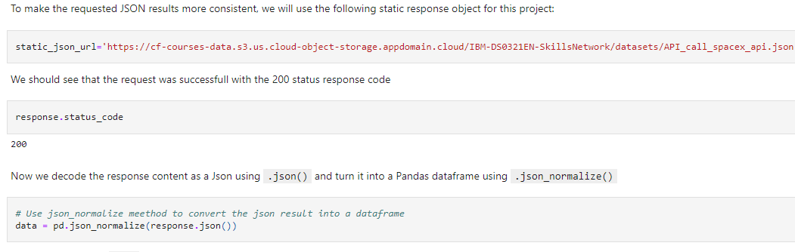
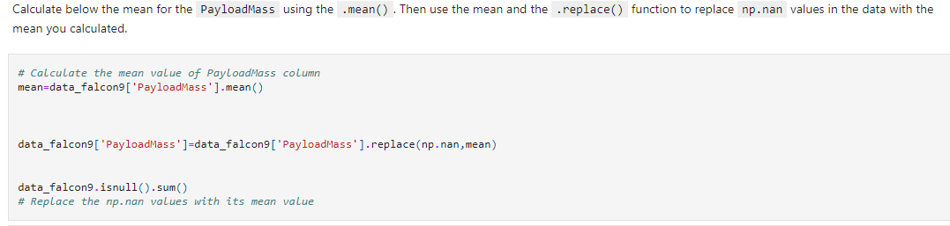
Data Collection – SpaceX API
We requested data from SpaceX API to collect data, clean the data and did basic data formatting.
SpaceX_IBM/data-collection-api-spacexv2.ipynb at b0375adf5ad05680ea6c4b8e70be32151251c383 · amppppppp/SpaceX_IBM (github.com)
1. Get data from URL using SpaceX API and turn into pandas dataframe
2. Replace some missing values

Slide 9
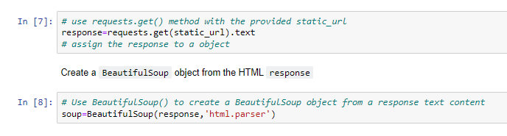
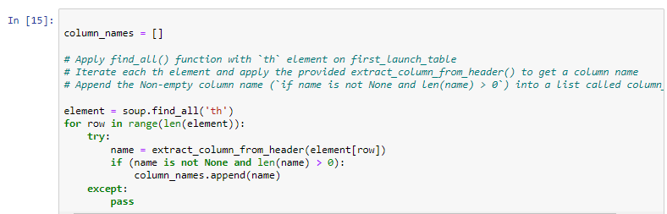
Data Collection - Scraping
1. Apply HTTP get method to request data from website and create BeautifulSoup object
Using Beautifulsoup to scraping from Wikipedia website to get Falcon 9 flight records. We parsed the table and turned into pandas dataframe.
SpaceX_IBM/data-collection-webscraping-spacex.ipynb at main · amppppppp/SpaceX_IBM (github.com)
2.Extract all column names from HTML table header
3. Create pandas dataframe from HTML tables

Slide 10
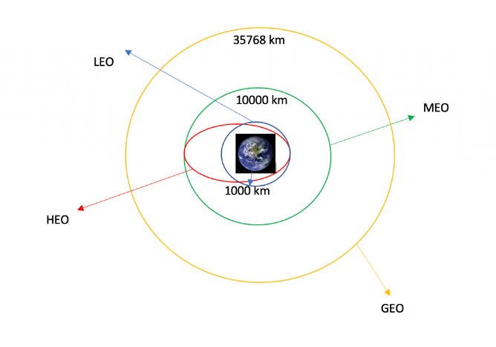
Data Wrangling
The exploratory analysis was performed and training labels were determined.
We calculated the number of Falcon 9’s launches on each site. Moreover, the number and occurrence of each orbits.
We also created a landing outcome label for further analysis.
SpaceX_IBM/Data-wrangling-spacex.ipynb at main · amppppppp/SpaceX_IBM (github.com)

Slide 11
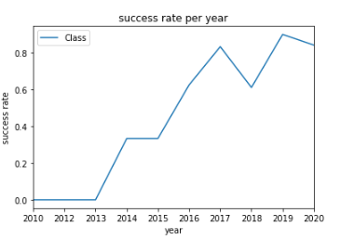
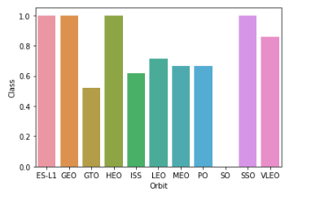
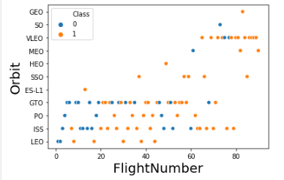
EDA with Data Visualization
We used visualization to show relationship between different features from the dataset such as success rate vs orbit type, number of flight vs Orbit type, payload weight vs orbit types ,and overall success rate of landing from 2010-2020.
SpaceX_IBM/eda-dataviz-spacex.ipynb at main · amppppppp/SpaceX_IBM (github.com)

Slide 12
EDA with SQL
We applied EDA with SQL using many SQL command for doing tasks such as
Display distinct launching sites name
Display payload mass by specific booster version
List the date when first successful landing on land
List name of boosters which success in drone ship and specific payload mass range
Rank the successful landing outcomes within date range.
SpaceX_IBM/eda-sql-coursera_sqllite.ipynb at main · amppppppp/SpaceX_IBM (github.com)

Slide 13
Build an Interactive Map with Folium
We marked Mark the success/failed launches for each site on the map and calculate the distances between a launch site on Folium map.
The feature outcomes were assigned to 1 for success and 0 for failure.
We also calculated between launch site and its proximityies such as railway, highway and city.
SpaceX_IBM/launch_site_location-gro-spacex.ipynb at main · amppppppp/SpaceX_IBM (github.com)

Slide 14
Build a Dashboard with Plotly Dash
We plotted pie chars showing the total launches by a certain sites and scatter graph showing relationship between outcome and payload mass for different booster version.
SpaceX_IBM/plotly-spacex at main · amppppppp/SpaceX_IBM (github.com)

Slide 15
Predictive Analysis (Classification)
We loaded data using numpy and pandas .Then, we prepare data for training ML model by split the data into testing set and training set.
We built different ML models and tune different hyperparameters using GridSearch
The best performing classification is Decision Tree
SpaceX_IBM/Machine Learning Prediction_SpaceX_.ipynb at main · amppppppp/SpaceX_IBM (github.com)

Slide 16
Results
Exploratory data analysis results
Interactive analytics demo in screenshots
Predictive analysis results

Slide 17

Section 2

Slide 18
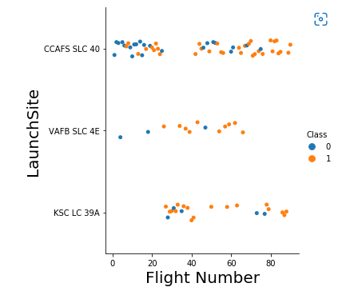
Flight Number vs. Launch Site
We found that the larger the flight amount at a launch site, the greater the success rate at a launch site.

Slide 19
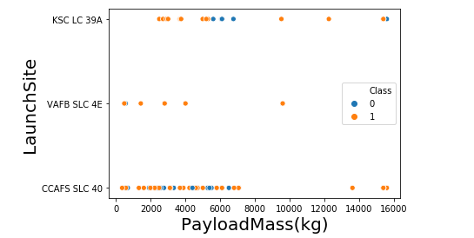
Payload vs. Launch Site
The greater the payload mass at CCAFS SLC 40 means, the higher success rate for the rocket

Slide 20
Success Rate vs. Orbit Type
ES-L1,GEO, SSO, VLEO has the highest rate of success among the other orbit type

Slide 21
Flight Number vs. Orbit Type
It can be seen that most of orbit type has no relationship between flight number and the orbit type

Slide 22
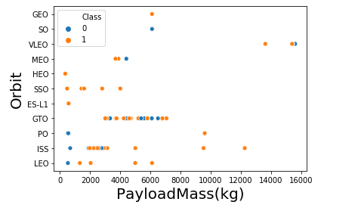
Payload vs. Orbit Type
PO, LEO, ISS had successful landing with heavier load.

Slide 23
Launch Success Yearly Trend
From the plot, it can be observed that success rate since 2013 kept on increasing till 2020.

Slide 24
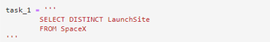
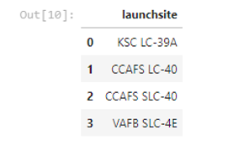
All Launch Site Names
Using DISTINCT to show only unique

Slide 25
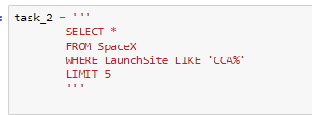
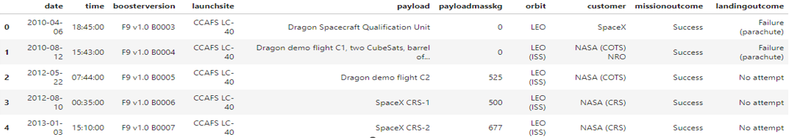
Launch Site Names Begin with 'CCA'
Using where to input condition of searching name with ‘CCA’

Slide 26
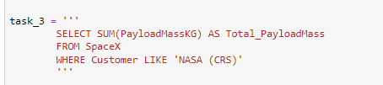
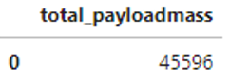
Total Payload Mass

Slide 27
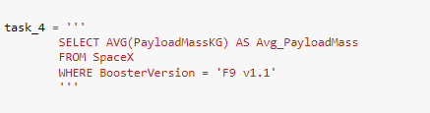
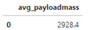
Average Payload Mass by F9 v1.1

Slide 28
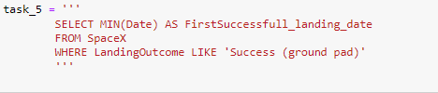
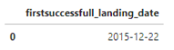
First Successful Ground Landing Date

Slide 29
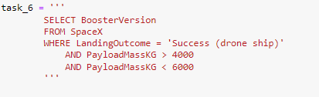
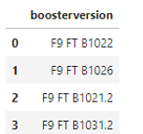
Successful Drone Ship Landing with Payload between 4000 and 6000

Slide 30
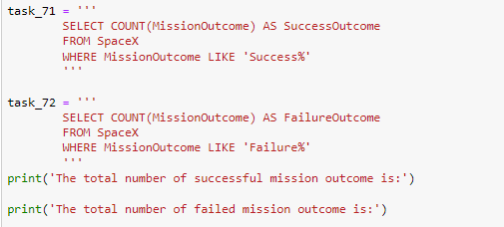
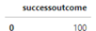
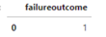
Total Number of Successful and Failure Mission Outcomes

Slide 31
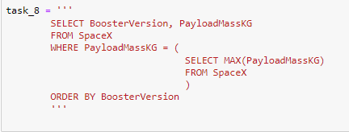
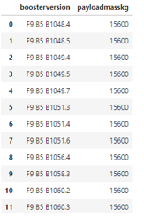
Boosters Carried Maximum Payload

Slide 32
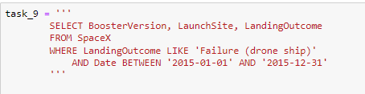
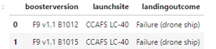
2015 Launch Records

Slide 33
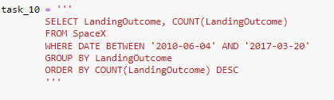
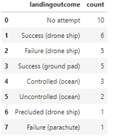
Rank Landing Outcomes Between 2010-06-04 and 2017-03-20

Slide 34

Section 3

Slide 35
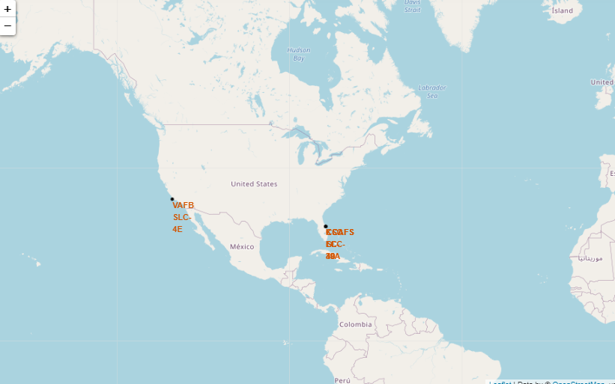
All Launch site on Map

Slide 36
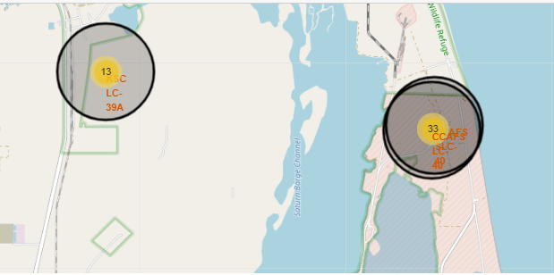
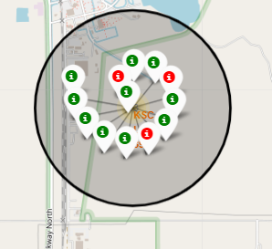
success/failed launches for each site on the map
Green : successful landing
Red : Fail landing

Slide 37
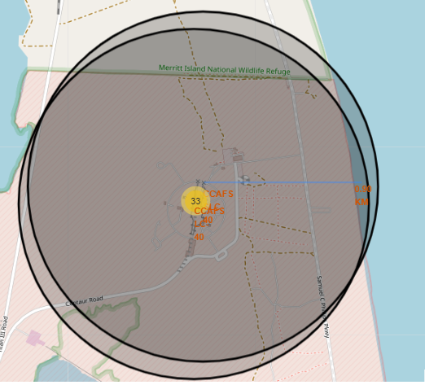
Launch Site distance to landmarks
The blue line show that the launch site is near the coastline around 900 meter from the launch site

Slide 38

Section 4

Slide 39
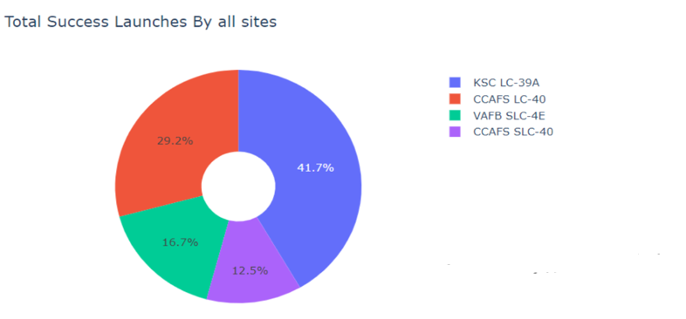
Total Success Launches by all sites
It can see that KSC LC-39A had the highest successful launches among all sites.

Slide 40
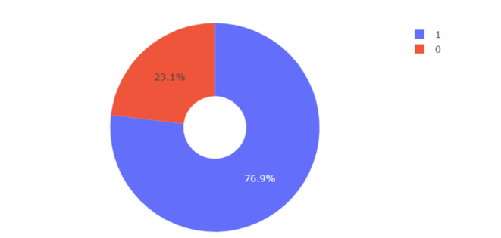
Launch site with the highest launch success ratio
The pie chart show ratio of success and fail launch of KSC LC-39A site.

Slide 41
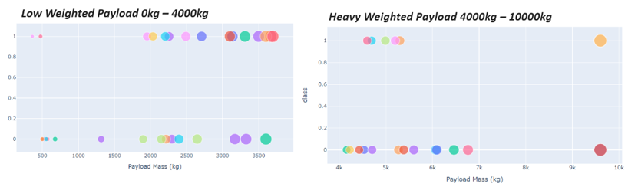
Scatter plot of payload vs launch outcome comparing between low and heavy payload
It can be seen that low weighted payload has higher success rates comparing to heavy payload.

Slide 42

Section 5

Slide 43
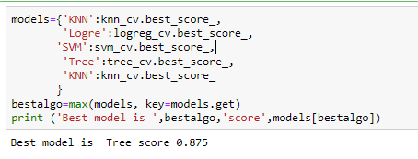
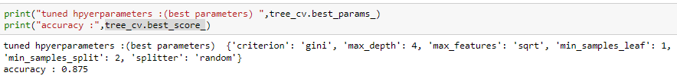
Classification Accuracy

Slide 44
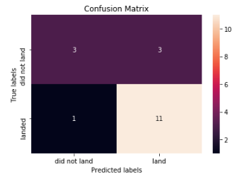
Confusion Matrix
Show the confusion matrix of decision tree classifier show the result of prediction compare to true result. It can distinguish between the different classes .

Slide 45
Conclusions
To summarize,
The larger number of flights at launch site, the greater success rate at launch site
The success rate tend to increase year by year. Reference from 2013-2020
Launch at the orbit type ES-L1,GEO, SSO, VLEO has the highest rate of success among the other orbit type
KSC LC-39A had the most successful launches of any sites
The best classifier for this task is decision tree

Slide 46
Appendix
Include any relevant assets like Python code snippets, SQL queries, charts, Notebook outputs, or data sets that you may have created during this project

Slide 47


